Slide 1
Product Information (PI) Standard
March 2019
Eoin.kelly@applia-europe.eu

Slide 2
APPLiA
APPLiA - Home Appliance Europe represents home appliance manufacturers from across Europe.
By promoting innovative, sustainable policies and solutions for EU homes, APPLiA has helped build the sector into an economic powerhouse, with an annual turnover of EUR 47.6 billion, investing over EUR 1.4 billion in R&D activities and creating nearly 1 million jobs.

Slide 3
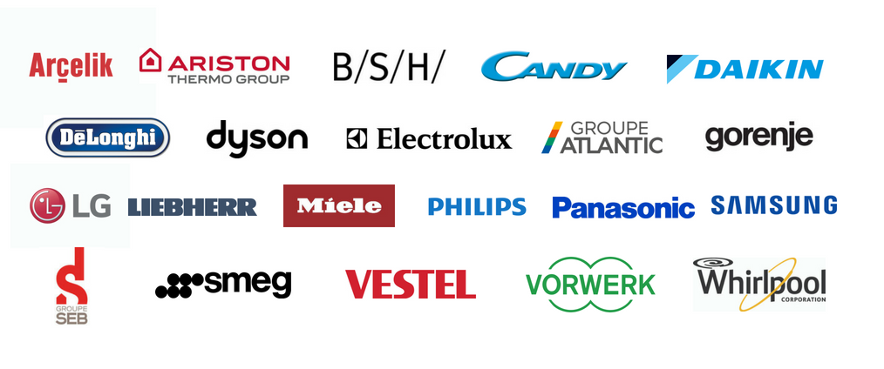
Direct Members

Slide 4
What is the PI Standard?
One harmonized standard defined by manufacturers
Ensures the communication of brand-specific values
Having a clear marketing differentiation
The initiative helps manufacturers, retailers, and consumers to take full advantage of modern developments in electronic communication and data processing
Introduction to PI Standard

Slide 5
Who develops & maintains the PI Standard?
PI certified companies

Slide 6
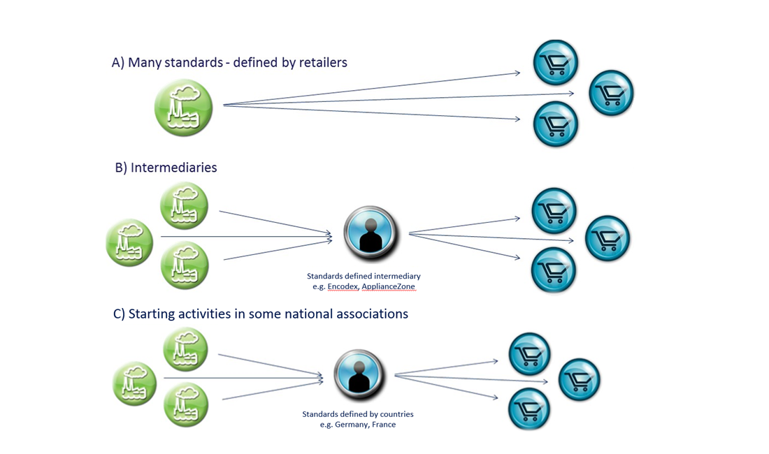
Why was PI Standard created?

Slide 7
How does it work now?
Defined by manufacturers
Used for all trading partners
Ensures the communication of brand-specific values
Having a clear marketing differentiation
One harmonized standard

Slide 8
PI Data – What kind of information is included?
Basics
Energy Label
Features
Marketing & Communication
Brand name
GTIN
Article no.
Voltage
Colour
Measurements
Etc.
Energy efficiency class
Energy consumption
Noise
Product fiche
Etc.
Wash options
Materials
Additional Options
Special programmes
Etc.
Logo’s
Product images
Panel images
Measurement images
USP
Etc.
EPREL
Example: washing machines

Slide 9
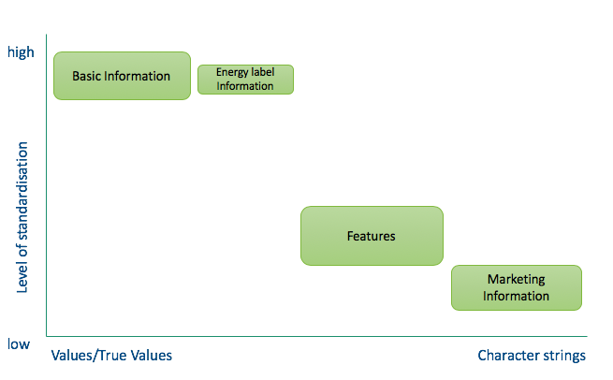
PI Data
Level of standardisation in PI data

Slide 10
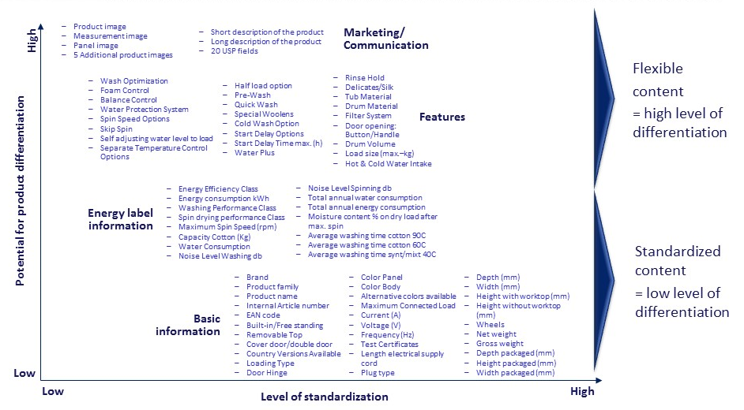
Example: Basic information
Brand
Product family
Product name
Internal article number

Slide 11
Example: Energy Label Information
Energy efficiency class
Energy Consumption
Washing performance class

Slide 12
Example: Features
Wash optimization
Foam control
Balance control
Water protection system
Spin speed options

Slide 13
Example: Marketing & Communication
Product image
Measurement image
Panel image
5 Additional product images

Slide 14
Benefits
For trade
One structure across all manufacturer brands
For manufacturers
Bi-lateral retailer contact without interference
Complete & correct information
Latest updated information
Free of charge
Direct contact between manufacturer and retailer
Electronic availability over the Internet
Full control over use of product information
Communication of complete information
Better support of brand value
Usage for different cross-media applications
One standard for many solutions

Slide 15
What has PI done so far?
Began with version 12.2 in the year 2000
Current version: 17.0 released in March 2019
Latest products (i.e. vacuum robot, combi steam oven)
Latest technical developments
Up-to-date energy label, EPREL & product fiche information
Partners/compatibility: eCl@ss, GS1, ETIM, GfK, Tradeplace, IEC
Current version: 17.0

Slide 16
What has PI done so far?
Different language versions
Available in 14 official EU languages: DE, DK, EL, EN, ES, FI, FR, IT, NL, NO, PL, PT, SL, SV
New languages would be provided: BG, ET, GA, HR, CS, HU, RO, SK, LT, LV, TU, RU, and UK

Slide 17
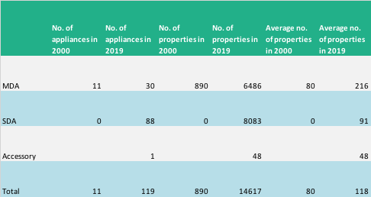
What has PI done so far?
Starting with 11 MDA product groups in 2000, the Standard has grown a lot:
Changes due to: new product groups, new EU legislation, new & old technology

Slide 18
PI Standard organisation
APPLiA PI Working Group (PI WG)
Meeting 2-3 times a year + monthly conference calls
To determine the content of the PI Standard
Budget: €22.000 in 2018, divided by all participants
Invited participants: all brands selling in Europe

Slide 19
How can you join?
PI Standard
Eligible: all companies, retailers, individuals interested
No need to be a member of PI Organization
Free of charge
Get started: http://www.picertified.com
PI Organization
Eligible: all brands selling in Europe
Conditions: adhere to PI Certified agreement
Fees: entrance fees & annual fee
Please contact APPLiA Secretariat

Slide 20
Eoin.kelly@applia-europe.eu

